Slide 1


Introduction and rationale:
Resilience quantification approaches in general
and residual-based methods in particular
Raffael Kalisch
Leibniz Institute for Resilience Research (LIR), Mainz, Germany
Neuroimaging Center (NIC), Focus Program Translational Neuroscience (FTN), Johannes Gutenberg University Medical Center, Mainz, Germany

Slide 2
Thanks to:
Amsterdam:
Ilya Veer
Berlin:
Cora Sachs
Zala Reppmann
Antje Riepenhausen
Caroline Wackerhagen
Henrik Walter
Esslingen:
Andrea Chmitorz
Frankfurt:
Kira Ahrens
Christian Fiebach
Rebecca Neumann
Michael Plichta
Andreas Reif
Charlotte Schenk
Freiburg:
Harald Binder
Göran Köber
Shakoor Pooseh
Jens Timmer
Landau:
Ulrike Basten
Leuven:
Inez Myin-Germeys
Jeroen Weermeijer
Mainz:
Hanno Burger
Manuela Götz
Raffael Kalisch
Bianca Kollmann
Klaus Lieb
Papoula Petri-Romao
Lara Puhlmann
Alexandra Sebastian
Oliver Tüscher
Michèle Wessa
Kenneth SL Yuen
Matthias Zerban
Mannheim:
Anita Schick
Nijmegen:
Sophie Bögemann
Erno Hermans
Guillén Fernàndez
Karin Roelofs
Judith van Leeuwen
Oslo:
Haakon Engen
Tel Aviv:
Talma Hendler
Netali Mor
Sapir Bar
Warsaw:
Dorota Kobylinska
Julek Mituniewicz
Aleksandra Uscilko
Zurich:
Birgit Kleim
Marta Marciniak

Slide 3
What is resilience?
“Except for the main idea of facing challenges, it is somewhat difficult to guess that all of those definitions concern the same subject.”
(M. Pecillo, 2016)

Slide 4
A (very) brief history of resilience research
Trait
Hardiness (Kobasa, 1979)
Ego resiliency (Block and Block, 1980)
Multiple factors
Various traits, skills, behaviors, beliefs, …
(Masten & Garmezy, 1985; Werner & Smith, 1989)
Processes
Individual change
Person-environment transactions
(Luthar et al., 2000; a.m.o.)
Outcome
Masten & Garmezy, 1985

Slide 5
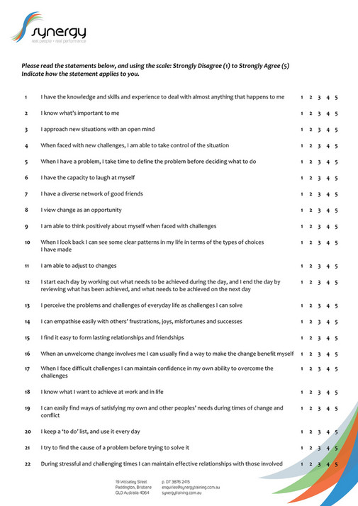

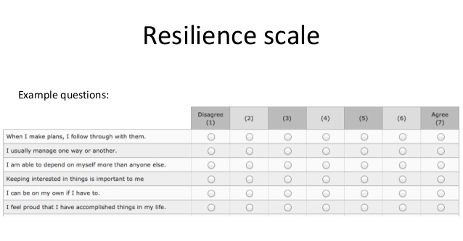
The reality of resilience research
Notes:
All good, isn‘t it?
One new thing: we have to do neurobio now
Second: there is a more profound problem with lists

Slide 6
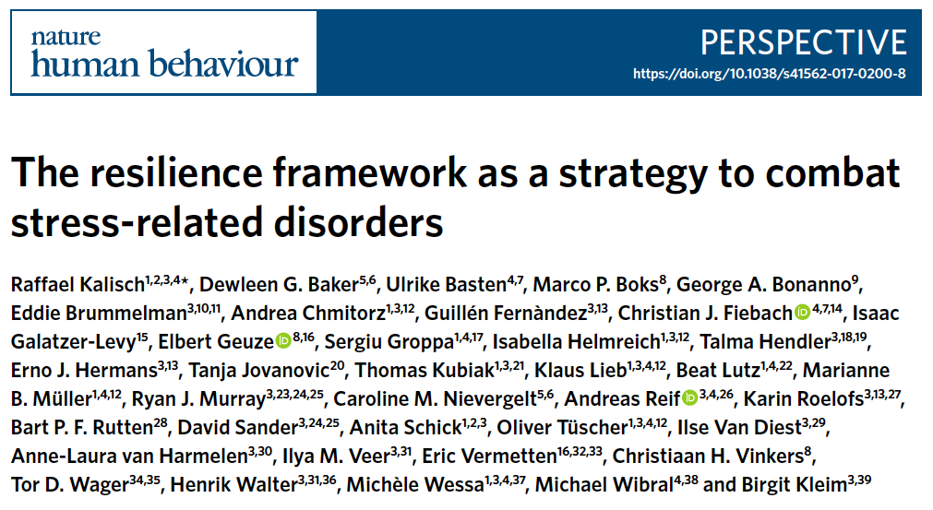
Notes:
Purely operational and purely pragmatic
No word about what the processes or resileince mechanisms or baseline predictors are
i.e., atheoretical → does not exclude any theoretical school
Great possibilty:
Now we can focus on the processes that lead to the outcome
And also on possible baseline predictors
Ex: emotion regulation skill as factor, process: use of it, perhaps inspired, training/improvement → not stable

Slide 7
If resilience is not a trait, what then?
Resilience is the maintenance or quick recovery of mental health during and after periods of adversity
(traumatizing events, challenging life circumstances or transitions, physical illness...)
Notes:
Purely operational and purely pragmatic
No word about what the processes or resileince mechanisms or baseline predictors are
i.e., atheoretical → does not exclude any theoretical school
Great possibilty:
Now we can focus on the processes that lead to the outcome
And also on possible baseline predictors
Ex: emotion regulation skill as factor, process: use of it, perhaps inspired, training/improvement → not stable

Slide 8
If resilience is not a trait, what then?
Resilience is the maintenance or quick recovery of mental health during and after periods of adversity
(traumatizing events, challenging life circumstances or transitions, physical illness...)
Resilience is NOT …
… any specific process or mechanism leading to the outcome (“resilience processes“, RPs)
… any baseline predictor or biomarkers (“resilience factors“, RFs)
… just the opposite of risk, or vulnerability
Notes:
Purely operational and purely pragmatic
No word about what the processes or resileince mechanisms or baseline predictors are
i.e., atheoretical → does not exclude any theoretical school
Great possibilty:
Now we can focus on the processes that lead to the outcome
And also on possible baseline predictors
Ex: emotion regulation skill as factor, process: use of it, perhaps inspired, training/improvement → not stable

Slide 9
If resilience is not a trait, what then?
Resilience is the maintenance or quick recovery of mental health during and after periods of adversity
(traumatizing events, challenging life circumstances or transitions, physical illness...)
Resilience is NOT …
… any specific process or mechanism leading to the outcome (“resilience processes“, RPs)
… any baseline predictor or biomarkers (“resilience factors“, RFs)
… just the opposite of risk, or vulnerability
BUT:
You can ask which RFs predict the outcome or which RPs lead to the outcome
Notes:
Purely operational and purely pragmatic
No word about what the processes or resileince mechanisms or baseline predictors are
i.e., atheoretical → does not exclude any theoretical school
Great possibilty:
Now we can focus on the processes that lead to the outcome
And also on possible baseline predictors
Ex: emotion regulation skill as factor, process: use of it, perhaps inspired, training/improvement → not stable

Slide 10
If resilience is not a trait, what then?
Resilience is the maintenance or quick recovery of mental health during and after periods of adversity
(traumatizing events, challenging life circumstances or transitions, physical illness...)
Resilience is NOT …
… any specific process or mechanism leading to the outcome (“resilience processes“, RPs)
… any baseline predictor or biomarkers (“resilience factors“, RFs)
… just the opposite of risk, or vulnerability
Outcome-based definition is purely operational and atheoretical
Requires longitudinal studies
Notes:
Purely operational and purely pragmatic
No word about what the processes or resileince mechanisms or baseline predictors are
i.e., atheoretical → does not exclude any theoretical school
Great possibilty:
Now we can focus on the processes that lead to the outcome
And also on possible baseline predictors
Ex: emotion regulation skill as factor, process: use of it, perhaps inspired, training/improvement → not stable

Slide 11
Resilience – outcome-based operationalization
T2 outcome:
T1
T2
ΔΣD
R
(dysfunctions)
(resilience)
S
N
Σ
O
D
T2
L
I
A
T
T
C
Σ
Σ
N
N
D
T1
D
T2
E
U
M
F
R_{T2} = 1 / (ΔΣP / ΣS)
= ΣS / ΔΣP
S
D
Y
Σ
D
T2
STRESSORS
Normalization to stressors!
Notes:
Simplified way, simple ideal situation
Hidden:
No cut-off between health and disease: dimensionality/continuous
Open: what type of D (all as in GHQ, or only specific dimension, such as anxiety or impulsivity, or symptom dimension such as PTS symptoms)
Open: what type of stressors (numbering LEs, or also looking at microstressors, daily hassles)
But not open: continuous measure

Slide 12
Resilience – outcome-based operationalization
Problem 1: unpredictability of stressors
Notes:
Simplified way, simple ideal situation
Hidden:
No cut-off between health and disease: dimensionality/continuous
Open: what type of D (all as in GHQ, or only specific dimension, such as anxiety or impulsivity, or symptom dimension such as PTS symptoms)
Open: what type of stressors (numbering LEs, or also looking at microstressors, daily hassles)
But not open: continuous measure

Slide 13
Resilience – outcome-based operationalization
T2 outcome:
T1
T2
ΔΣD
R
(dysfunctions)
(resilience)
S
N
Σ
O
D
T2
L
I
A
T
T
C
Σ
Σ
N
N
D
T1
D
T2
E
U
M
F
R_{T2} = 1 / (ΔΣP / ΣS)
= ΣS / ΔΣP
S
D
Y
Σ
D
T2
STRESSORS
Normalization to stressors!
Notes:
Simplified way, simple ideal situation
Hidden:
No cut-off between health and disease: dimensionality/continuous
Open: what type of D (all as in GHQ, or only specific dimension, such as anxiety or impulsivity, or symptom dimension such as PTS symptoms)
Open: what type of stressors (numbering LEs, or also looking at microstressors, daily hassles)
But not open: continuous measure

Slide 14
Resilience – outcome-based operationalization
Problem 1: unpredictability of stressors
Problem 2: heterogeneity of stressors
Notes:
Simplified way, simple ideal situation
Hidden:
No cut-off between health and disease: dimensionality/continuous
Open: what type of D (all as in GHQ, or only specific dimension, such as anxiety or impulsivity, or symptom dimension such as PTS symptoms)
Open: what type of stressors (numbering LEs, or also looking at microstressors, daily hassles)
But not open: continuous measure

Slide 15
Resilience – outcome-based operationalization
Problem 1: unpredictability of stressors
Problem 2: heterogeneity of stressors
Problem 3: non-randomness of stressors
Notes:
Simplified way, simple ideal situation
Hidden:
No cut-off between health and disease: dimensionality/continuous
Open: what type of D (all as in GHQ, or only specific dimension, such as anxiety or impulsivity, or symptom dimension such as PTS symptoms)
Open: what type of stressors (numbering LEs, or also looking at microstressors, daily hassles)
But not open: continuous measure

Slide 16
Resilience – outcome-based operationalization
Problem 1: unpredictability of stressors
Problem 2: heterogeneity of stressors
Problem 3: non-randomness of stressors
Problem 4: individuality of stressors
Notes:
Simplified way, simple ideal situation
Hidden:
No cut-off between health and disease: dimensionality/continuous
Open: what type of D (all as in GHQ, or only specific dimension, such as anxiety or impulsivity, or symptom dimension such as PTS symptoms)
Open: what type of stressors (numbering LEs, or also looking at microstressors, daily hassles)
But not open: continuous measure

Slide 17
Resilience – outcome-based operationalization
Problem 1: unpredictability of stressors
Problem 2: heterogeneity of stressors
Problem 3: non-randomness of stressors
Problem 4: individuality of stressors
Problem 5: subjectivity of stressors
Notes:
Simplified way, simple ideal situation
Hidden:
No cut-off between health and disease: dimensionality/continuous
Open: what type of D (all as in GHQ, or only specific dimension, such as anxiety or impulsivity, or symptom dimension such as PTS symptoms)
Open: what type of stressors (numbering LEs, or also looking at microstressors, daily hassles)
But not open: continuous measure

Slide 18
What is resilience?
“Except for the main idea of facing challenges, it is somewhat difficult to guess that all of those definitions concern the same subject.”
(M. Pecillo, 2016)

Slide 19
What is resilience?
“Except for the main idea of having to quantify challenges, it is somewhat difficult to guess how all of those aspects could be satisfactorily addressed.”
(R. Kalisch, 2023)

Slide 20
Resilience – outcome-based operationalization
Solution 1: take an at-risk population
Kalisch et al., Front Psychol 2021
Notes:
Simplified way, simple ideal situation
Hidden:
No cut-off between health and disease: dimensionality/continuous
Open: what type of D (all as in GHQ, or only specific dimension, such as anxiety or impulsivity, or symptom dimension such as PTS symptoms)
Open: what type of stressors (numbering LEs, or also looking at microstressors, daily hassles)
But not open: continuous measure

Slide 21

Resilience – outcome-based operationalization
Kalisch et al., Front Psychol 2021
Notes:
Extension to several time points

Slide 22
Resilience – outcome-based operationalization
Solution 1: take an at-risk population
Solution 2: frequently monitor stressors and mental health
Kalisch et al., Front Psychol 2021
Notes:
Simplified way, simple ideal situation
Hidden:
No cut-off between health and disease: dimensionality/continuous
Open: what type of D (all as in GHQ, or only specific dimension, such as anxiety or impulsivity, or symptom dimension such as PTS symptoms)
Open: what type of stressors (numbering LEs, or also looking at microstressors, daily hassles)
But not open: continuous measure

Slide 23
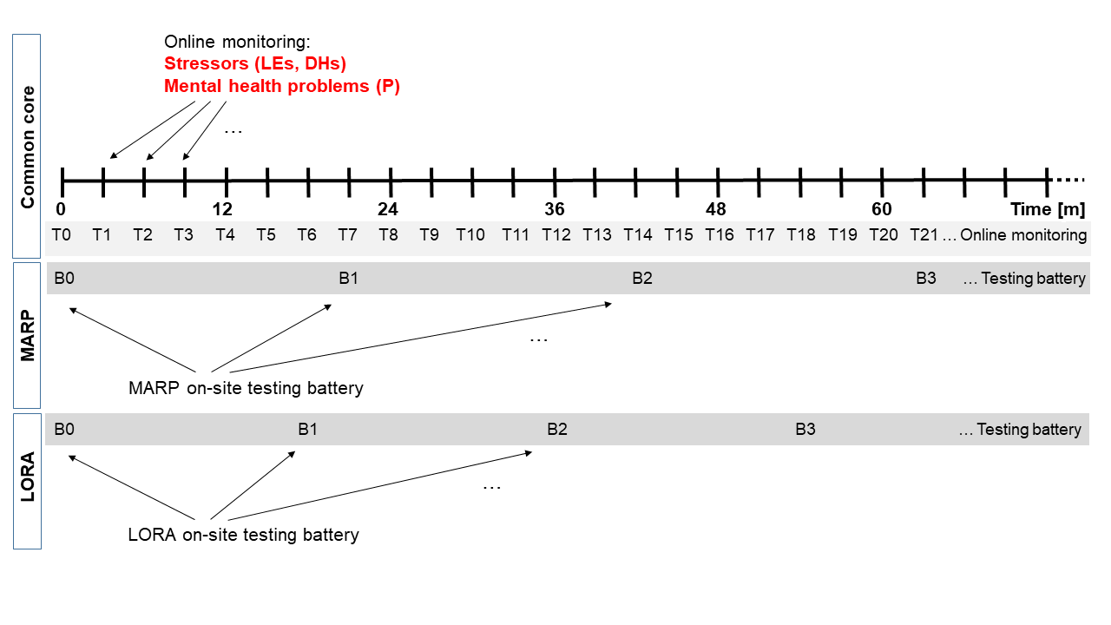
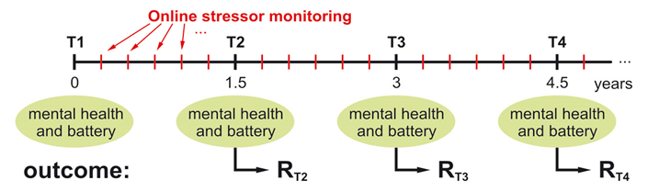
Resilience – outcome-based operationalization
Frequent Stressor and Health Monitoring paradigm (FRESHMO)
(E)
Online stressor & mental health monitoring
Battery
Battery
Battery
Battery
Kalisch et al., Front Psychol 2021
Notes:
Extension to several time points

Slide 24
Resilience – outcome-based operationalization
Frequent Stressor and Health Monitoring paradigm (FRESHMO)
(E)
Online stressor & mental health monitoring
Battery
Battery
Battery
Battery
Stressors (E): Life Events (LE) list
- 27 items
- occurrence in past 3 months?
- how many times?
- severity (appraisal)?
Kalisch et al., Front Psychol 2021
Notes:
Extension to several time points

Slide 25
Resilience – outcome-based operationalization
Frequent Stressor and Health Monitoring paradigm (FRESHMO)
(E)
Online stressor & mental health monitoring
Battery
Battery
Battery
Battery
Stressors (E): Life Events (LE) list
Daily Hassles (DH) list
- 58 items
- occurrence in past week?
- how many days?
- severity (appraisal)?
Kalisch et al., Front Psychol 2021
Notes:
Extension to several time points

Slide 26
Resilience – outcome-based operationalization
Frequent Stressor and Health Monitoring paradigm (FRESHMO)
(E)
Online stressor & mental health monitoring
Battery
Battery
Battery
Battery
Stressors (E): Life Events (LE) list
Daily Hassles (DH) list
Mental health (P): Internalizing symptoms
Kalisch et al., Front Psychol 2021
Notes:
Extension to several time points

Slide 27

Resilience – outcome-based operationalization
Average
T1…T3
Occurrence of stressors:
E_{DH} ~ E_{LE}: R=0.38, p=2e-06
(N=148)
Haakon Engen
Kalisch et al., Front Psychol 2021
Notes:
Extension to several time points

Slide 28
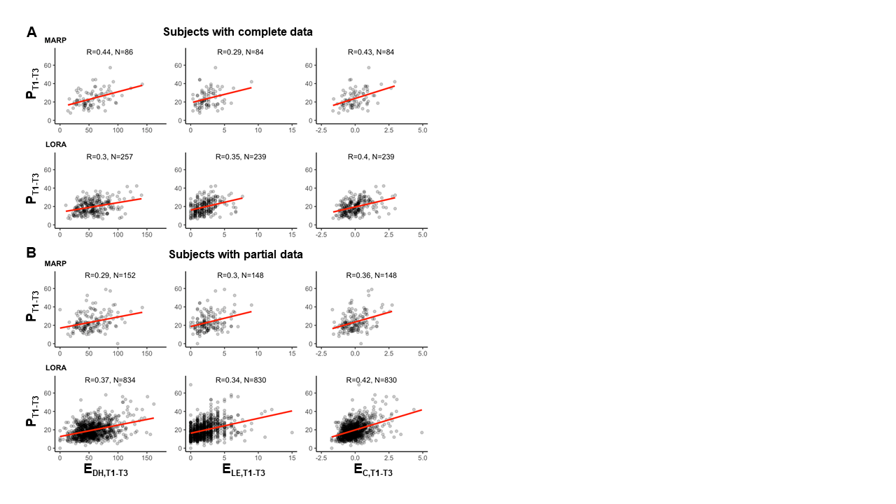
Resilience – outcome-based operationalization
Average
T1…T3
Occurrence of stressors:
E_{DH} ~ E_{LE}: R=0.38, p=2e-06
(N=148)
Haakon Engen
Kalisch et al., Front Psychol 2021
Notes:
Extension to several time points

Slide 29
Resilience – outcome-based operationalization
Solution 1: take an at-risk population
Solution 2: frequently monitor stressors and mental health
Solution 3: express mental health as a function of stressor exposure
Kalisch et al., Front Psychol 2021
Notes:
Simplified way, simple ideal situation
Hidden:
No cut-off between health and disease: dimensionality/continuous
Open: what type of D (all as in GHQ, or only specific dimension, such as anxiety or impulsivity, or symptom dimension such as PTS symptoms)
Open: what type of stressors (numbering LEs, or also looking at microstressors, daily hassles)
But not open: continuous measure

Slide 30
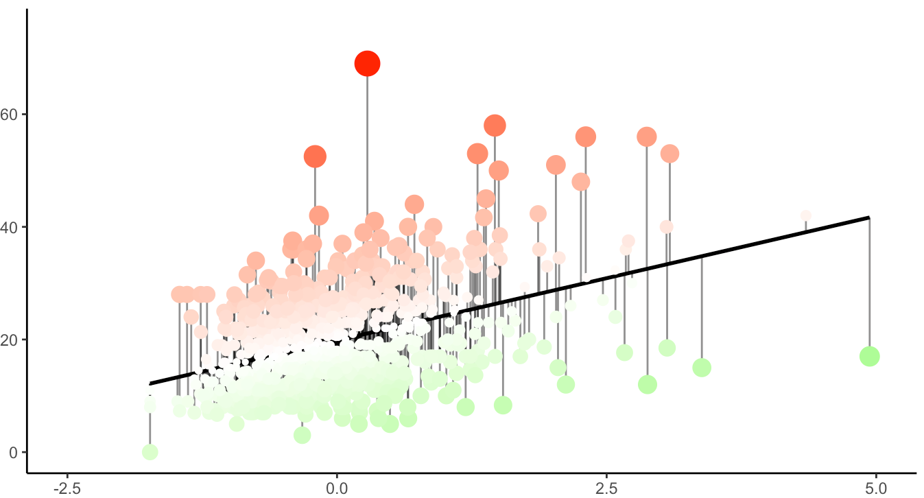
Resilience – outcome-based operationalization
Average
T1…T3
Mental health problems P_{T1-T3}
Haakon Engen
Stressor exposure E_{C,T1-T3}
Kalisch et al., Front Psychol 2021
Notes:
Extension to several time points

Slide 31
Resilience – outcome-based operationalization
Average
T1…T3
1
Mental health problems P_{T1-T3}
2
Haakon Engen
Stressor exposure E_{C,T1-T3}
Kalisch et al., Front Psychol 2021
Notes:
Extension to several time points

Slide 32
Resilience – outcome-based operationalization
Average
T1…T3
1
Mental health problems P_{T1-T3}
3
2
4
Haakon Engen
Stressor exposure E_{C,T1-T3}
Kalisch et al., Front Psychol 2021
Notes:
Extension to several time points

Slide 33
Resilience – outcome-based operationalization
Average
T1…T3
1
Mental health problems P_{T1-T3}
3
5
→ Stressor reactivity (SR) score
2
4
Haakon Engen
Stressor exposure E_{C,T1-T3}
Kalisch et al., Front Psychol 2021
Notes:
Extension to several time points

Slide 34
Resilience – stressor reactivity (SR) time course
Average
T1…T3
Average
T2…T4
Average
T3…T5
Haakon Engen
Kalisch et al., Front Psychol 2021
Notes:
Extension to several time points

Slide 35
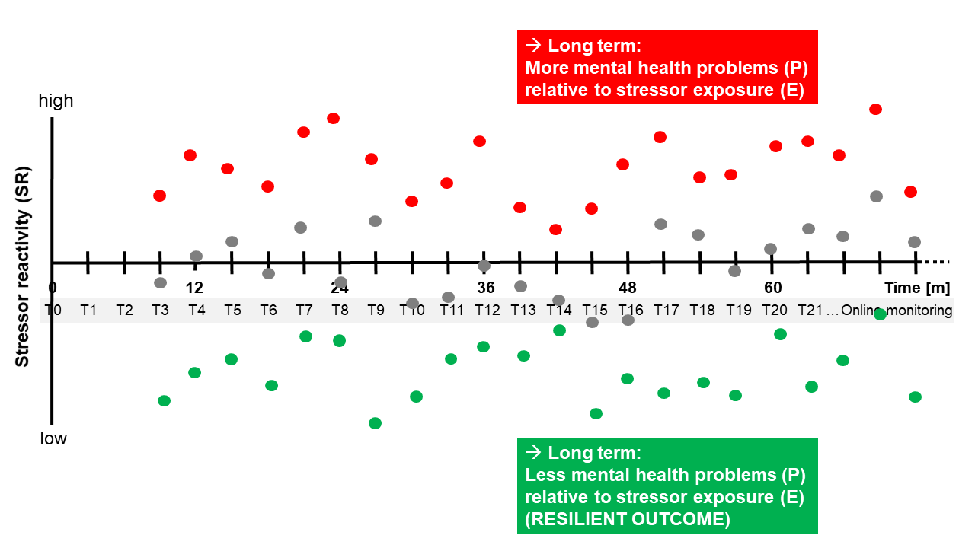
Resilience – stressor reactivity (SR) time course
Average
T1…T3
Average
T2…T4
Average
T3…T5
Haakon Engen
Kalisch et al., Front Psychol 2021
Notes:
Extension to several time points

Slide 36
Resilience – outcome-based operationalization
Problem 1: unpredictability of stressors
Problem 2: heterogeneity of stressors
Problem 3: non-randomness of stressors
Problem 4: individuality of stressors
Problem 5: subjectivity of stressors
Notes:
Simplified way, simple ideal situation
Hidden:
No cut-off between health and disease: dimensionality/continuous
Open: what type of D (all as in GHQ, or only specific dimension, such as anxiety or impulsivity, or symptom dimension such as PTS symptoms)
Open: what type of stressors (numbering LEs, or also looking at microstressors, daily hassles)
But not open: continuous measure

Slide 37
Resilience – stressor reactivity (SR) time course
Average
T1…T3
Average
T2…T4
Average
T3…T5
Kalisch et al., Front Psychol 2021
Notes:
Extension to several time points

Slide 38
Resilience – stressor reactivity (SR) time course
WHY?
Average
T1…T3
Average
T2…T4
Average
T3…T5
Kalisch et al., Front Psychol 2021
Notes:
Extension to several time points

Slide 39
Resilience – outcome-based operationalization
(E)
Online stressor & mental health monitoring
Battery
Battery
Battery
Battery
Kalisch et al., Front Psychol 2021
Notes:
Extension to several time points

Slide 40
Resilience – outcome-based operationalization
(E)
Online stressor & mental health monitoring
Battery
Battery
Battery
Battery
Kalisch et al., Front Psychol 2021
Notes:
Extension to several time points

Slide 41
Resilience – stressor reactivity (SR) time course
Average
T2…T4
Average
T3…T5
Resilience factors
Battery
variable X
(B0)
Kalisch et al., Front Psychol 2021
Notes:
Extension to several time points

Slide 42
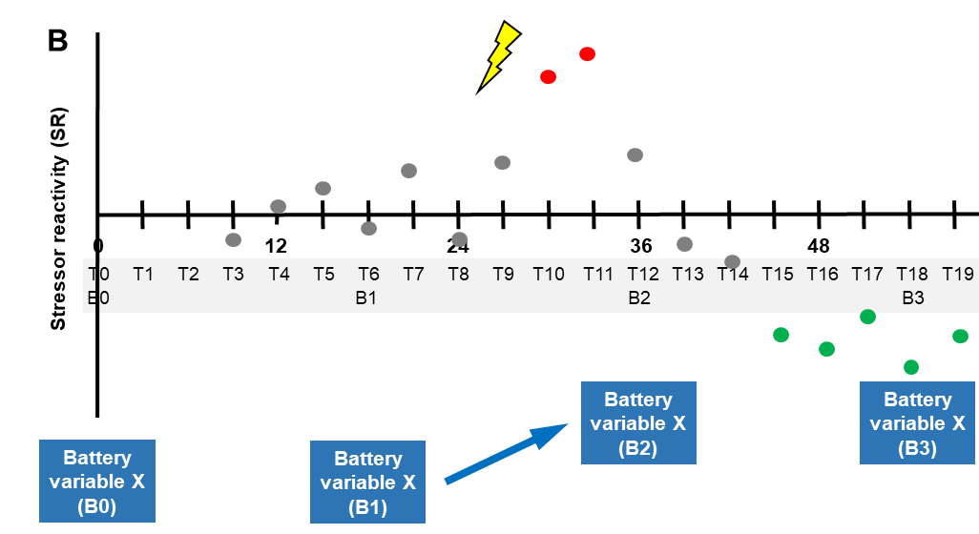
Resilience – stressor reactivity (SR) time course
Average
T2…T4
Average
T3…T5
Processes of change (adaptation)
= resilience processes
Kalisch et al., Front Psychol 2021
Notes:
Extension to several time points

Slide 43


Positive Appraisal Style (PAS) and resilience
Long-term SR
Online stressor & mental health monitoring
Battery
Battery
Battery
Battery
N=132
EV=19%
N=1034
EV=13%
Battery
Variable PAS(B0)
Papoula Petri-Romão
Petri-Romão et al., in prep.

Slide 44

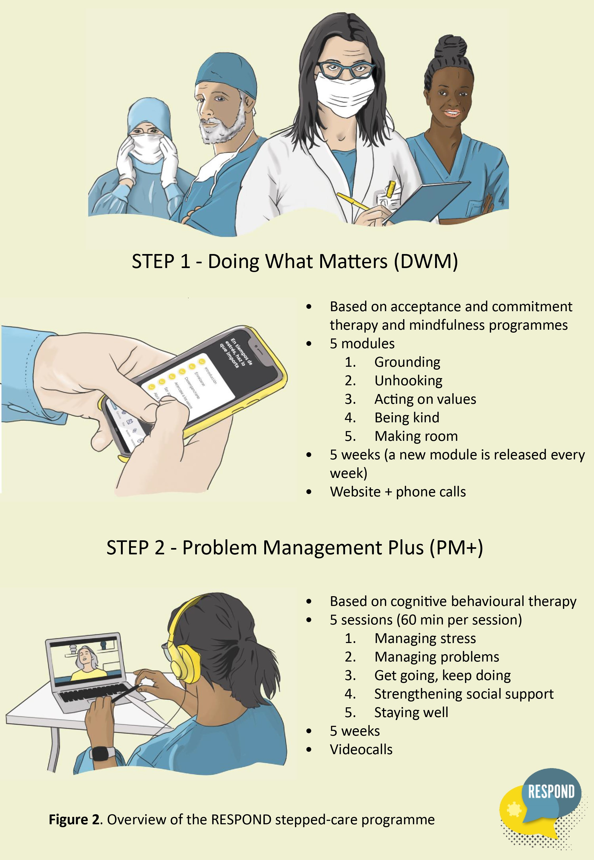
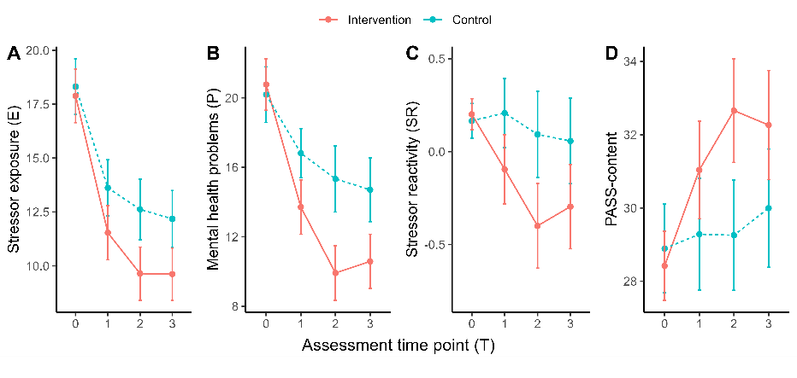
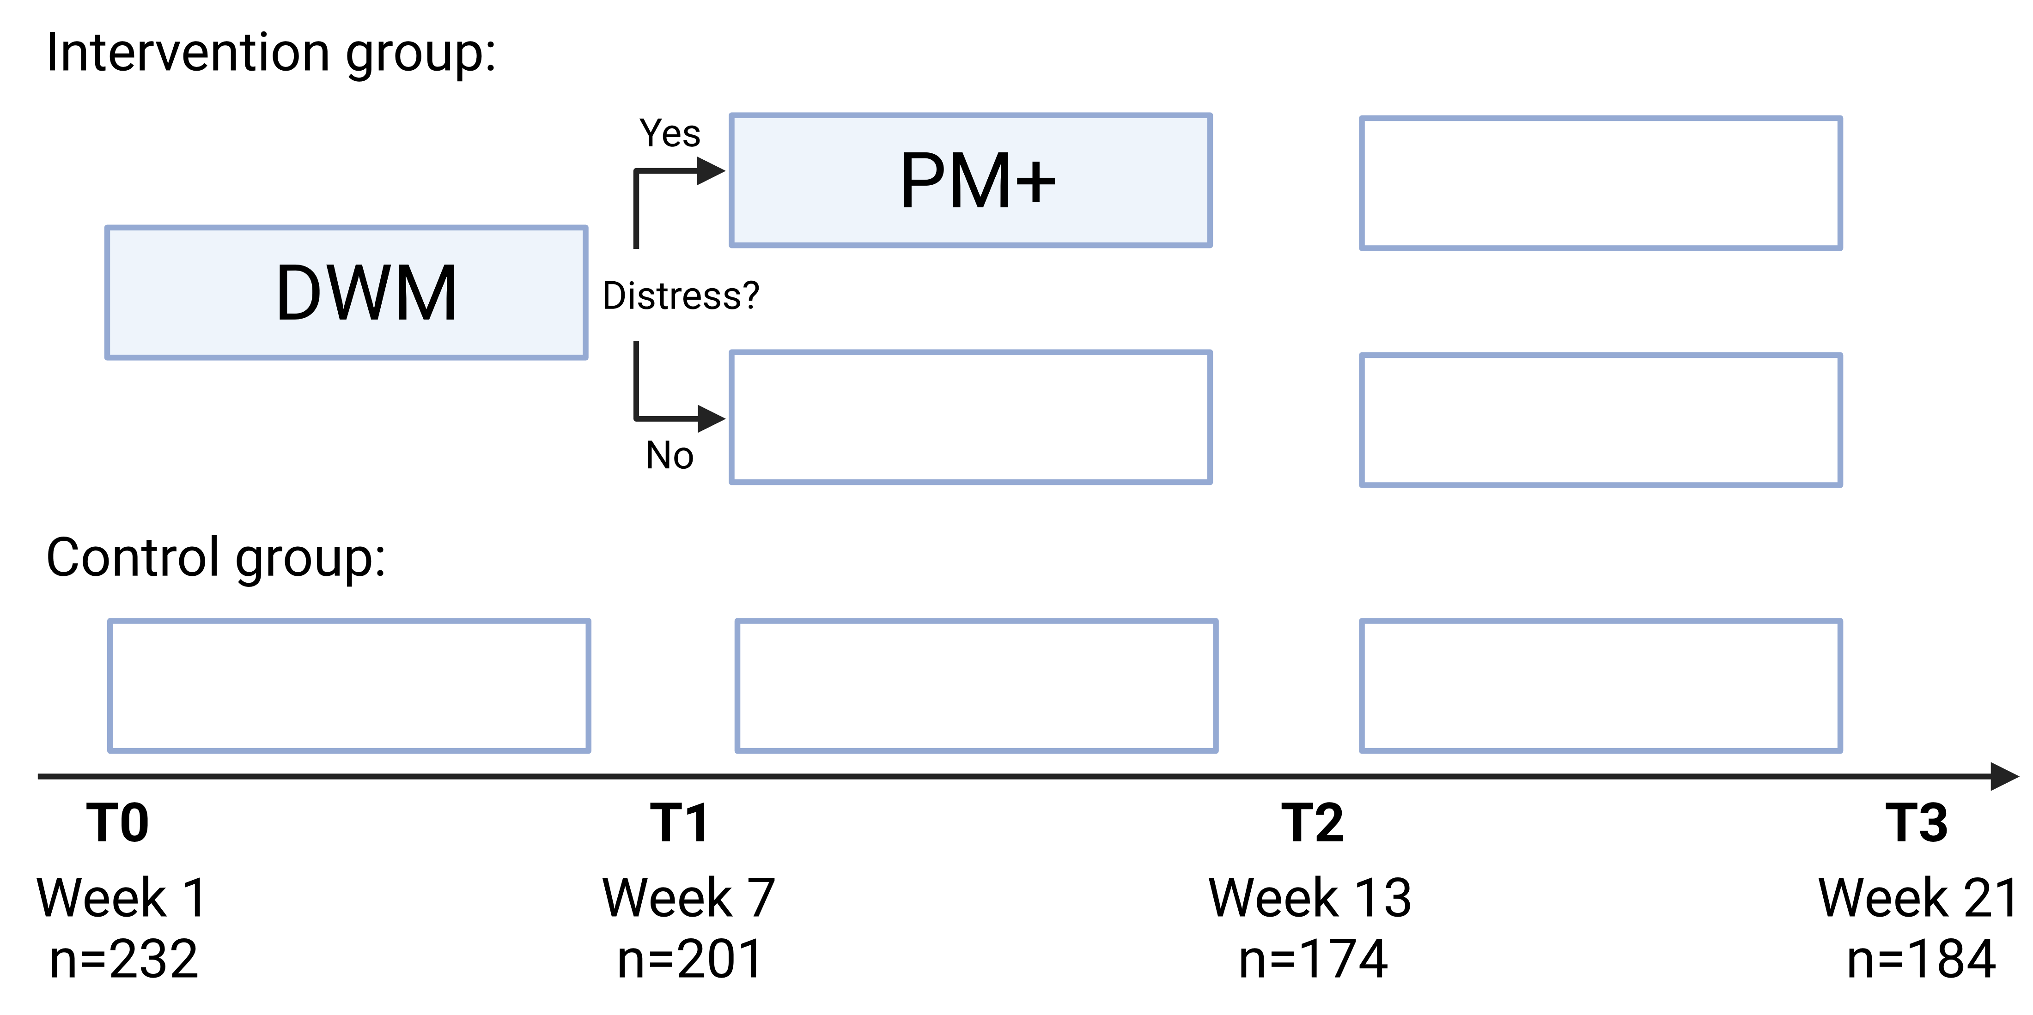
Positive Appraisal Style (PAS): towards causality
WHO Stress management training
(stepped care, peer support, digitalized)
Intervention → PAS (T2) → -SR (T3)
(47%)
Spanish health care workers
during COVID
3 more RCTs ongoing
Petri-Romão et al., in prep.

Slide 45
If resilience is not a trait, what then?
Resilience is the maintenance or quick recovery of mental health during and after periods of adversity
(traumatizing events, challenging life circumstances or transitions, physical illness...)
Resilience is NOT …
… any specific process or mechanism leading to the outcome (“resilience processes“, RPs)
… any baseline predictor or biomarkers (“resilience factors“, RFs)
Notes:
Purely operational and purely pragmatic
No word about what the processes or resileince mechanisms or baseline predictors are
i.e., atheoretical → does not exclude any theoretical school
Great possibilty:
Now we can focus on the processes that lead to the outcome
And also on possible baseline predictors
Ex: emotion regulation skill as factor, process: use of it, perhaps inspired, training/improvement → not stable

Slide 46
Resilience to major life events
Bonanno et al., Annu Rev Clin Psychol 2011
Notes:
Extension to several time points

Slide 47
Resilience to major life events
Bonanno et al., Annu Rev Clin Psychol 2011
Low symptoms because less adversity?
Major LEs often preceded & succeeded by other adversities (e.g., Norris and Uhl, 1993)
High SES predicts low symptoms (McGiffin et al., 2019)
Fewer unrelated stressors pre- & post-event predict low symptoms (Feder et al., 2016)
Correcting for “background“ stressors abolishes gender effects on resilience (Lowe et al., 2021)
Ahrens et al., in revis.
Notes:
Extension to several time points

Slide 48
Resilience – outcome-based operationalization
Problem 1: unpredictability of stressors
Problem 2: heterogeneity of stressors
Problem 3: non-randomness of stressors
Problem 4: individuality of stressors
Problem 5: subjectivity of stressors
Notes:
Simplified way, simple ideal situation
Hidden:
No cut-off between health and disease: dimensionality/continuous
Open: what type of D (all as in GHQ, or only specific dimension, such as anxiety or impulsivity, or symptom dimension such as PTS symptoms)
Open: what type of stressors (numbering LEs, or also looking at microstressors, daily hassles)
But not open: continuous measure

Slide 49
Resilience – outcome-based operationalization
Solution 1: take an at-risk population
Solution 2: frequently monitor stressors and mental health
Solution 3: express mental health as a function of stressor exposure
Notes:
Simplified way, simple ideal situation
Hidden:
No cut-off between health and disease: dimensionality/continuous
Open: what type of D (all as in GHQ, or only specific dimension, such as anxiety or impulsivity, or symptom dimension such as PTS symptoms)
Open: what type of stressors (numbering LEs, or also looking at microstressors, daily hassles)
But not open: continuous measure

Slide 50
Resilience – outcome-based operationalization
Possibility 1: identify resilience factors
Possibility 2: identify resilience processes and intervention effects
Possibility 3: quantify resilience to life events
Notes:
Simplified way, simple ideal situation
Hidden:
No cut-off between health and disease: dimensionality/continuous
Open: what type of D (all as in GHQ, or only specific dimension, such as anxiety or impulsivity, or symptom dimension such as PTS symptoms)
Open: what type of stressors (numbering LEs, or also looking at microstressors, daily hassles)
But not open: continuous measure

Slide 51
Resilience – outcome-based operationalization
Studies using a residual-based operationalization of outcome resilience
Non-exhaustive list
van der Heide et al., 2024; doi: 10(1):81. doi: 10.1038/s41531-024-00692-4
Cornwell et al., 2024; doi: 0.1093/scan/nsae006
Zerban et al., 2023; doi: 10.3389/fpsyg.2023.1272199
Bögemann et al., 2023; doi: 10:e46518. doi: 10.2196/46518
González-García et al., 2023; doi: 10.1017/S0954579423000901
Cahill et al., 2023; doi: 10.1017/S0954579423001165
Cornwell et al., 2022; doi: 10.1017/S0954579423000718
Cahill et al., 2022; doi: 10.1186/s13034-022-00449-y
Neumann et al., 2022; doi: 10.1007/s00406-021-01338-9
Veer et al., 2021; doi: 10.1038/s41398-020-01150-4
Van Harmelen et al., 2021; doi: 0.1007/s42844-020-00027-1
Sawyers et al., 2020; doi: 10.1002/da.23005
Van Harmelen et al., 2017; doi: 10.1017/S0033291717000836
Amstadter et al., 2016; doi: 10.1007/s00127-015-1163-6
Amstadter et al., 2014; doi: 10.1192/bjp.bp.113.130906
Sapouna and Wolke, 2013; doi: 0.1016/j.chiabu.2013.05.009
Miller-Lewis et al., 2013; doi: 10.1186/1753-2000-7-6
Bowes et al., 2010; doi: 10.1111/j.1469-7610.2010.02216.x
Boardman et al., 2008; doi: 10.1375/twin.11.1.12
Kim-Cohen et al., 2004; doi: 10.1111/j.1467-8624.2004.00699.x
Alternative terms (inverse residual):
‘resilient functioning‘
(van Harmelen et al., Psychol Med 2017)
‘discrepancy-based psychiatric resilience‘
(Sawyers et al., Depr Anx 2020)

Slide 52
Thank you!

